Slide 1

Working with Nanoparticles in the
Center for Sustainable Nanotechnology:
A practical primer on nanoparticle safety
Robert Hamers

Slide 2
Acknowledgment
This module is based in part on an 8-hour NP safety training course available at:
https://nanohub.org/groups/gng/training_materials
It has been shortened and adapted to meet the needs of CSN students/postdocs working with small (gram-scale or less) amounts of nanomaterials.
Notes:
This presentation is based on several different sources, but one of the most comprehensive is an 8-hour nanoparticle safety training course on the web at the URL indicated here. That nanohub course is largely oriented toward people who are involved in large-scale synthesis of nanomaterials, and so while while of their recommendations are useful, there are also substantial difference in what studnets are likey to encounter in CSN activities.

Slide 3
The Starting Point: Nanoparticles may have unknown properties
Many nanomaterials being used in the CSN have not been investigated extensively for human toxicity.
There are no procedures or equipment that are guaranteed to keep users “safe”
The amounts of materials being used are typically small enough that exposure and associated can be minimized
It is every researcher’s responsibility to determine effective safety procedures appropriate to your own laboratory environment and exposure/use patterns.
Notes:
Our starting must always be that nanomaterials have unknown properties. In the CSN we’re dealing with new materials that might not have been investigated broadly. So, we can’t expect to know the kind of detailed “safety “ information that one might have for a large-scale organic compound. Based on this, we ened to use our best estimated. Every lab within the CSN has different equipment and facilites,and so it’s not possible for a “synthesis” lab to determine what specific procedures should be put in place in a someone else’s lab. In the end, it’s always true that it’s the responsibilty of every researcher in the CSN to determine what safety procedures are necessary and appropriate in their area.

Slide 4
Incidental Nanoparticles’ Health Effects
Human Origin (Incidental) | Health Impacts
Cooking smoke | Pneumonia; chronic respiratory disease; lung cancer
Diesel exhaust | Cancer; respiratory disease
Welding fumes | Metal fume fever; infertility; benign pneumoconiosis
Industrial emissions/effluents | Asthma, atherosclerosis, chronic obstructive pulmonary disease
Sandblasting | Silicosis
Notes:
Trainer Notes:
Here are some of the documented effects from small particulate matter of human origin.
Sources
Cooking smoke: http://www.who.int/mediacentre/factsheets/fs292/en/index.html
Diesel exhaust: http://www.arb.ca.gov/research/diesel/diesel-health.htm
Welding fumes: http://www.osha.gov/SLTC/healthguidelines/weldingfumes/recognition.html
Industrial effluents: http://oehha.ca.gov/public_info/facts/airkids.html
Silicosis: http://www.cdc.gov/niosh/92-102.html

Slide 5
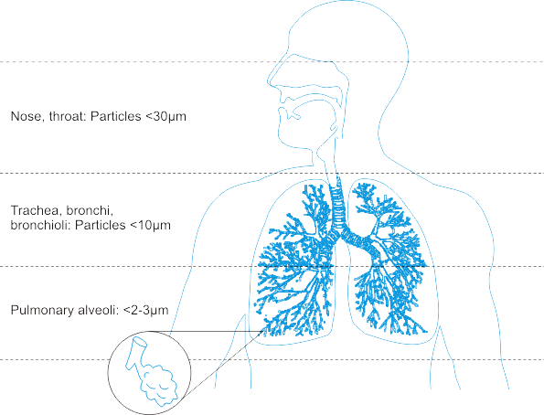
Routes of Exposure: Inhalation
Inhalation has been a major focus of the nanotoxicology community;
NP penetration into the lung depends on its aggregation state
Airborne NPs can be inhaled and deposit in the respiratory tract
Inhaled NPs may enter the blood stream and translocate to other organs
>10 microns: stopped by mucous
Small NPs can penetrate deeper and block alveoli
Image: http://upload.wikimedia.org/wikipedia/commons/3/36/Respiratory_Tract.png
Notes:
Trainer Notes:
The ability of a particle to deposit in the respiratory tract depends on its size. Particles larger than about 10 microns (10,000 nm) get trapped by the mouth, nose and throat; only particles less than ~10 microns enter the conductive airways (trachea and bronchi). Many of these particles are trapped by mucus and ultimately ingested. Nanoparticles’ small size permits them to be inhaled into the alveolar (deep) region of the lung where gas exchange occurs. For this reason, many studies and guidance documents have focused on inhalation as the primary route of exposure to nanoparticles in the workplace.
Animal studies have indicated that nanoparticles in the lung may be able to enter the bloodstream and translocate to other organs.
In many of these studies the nanoparticles were modified to prevent them from agglomerating together into particles larger than 2-3 microns. Some studies have shown that the primary effect of nanoparticles in the lung was asphyxiation when the particles clumped together and physically blocked the airways. The actual impact of a nanoparticle will depend critically on whether or not that nanoparticle agglomerates prior to or after entering the body.
SOURCE
Image: http://upload.wikimedia.org/wikipedia/commons/3/36/Respiratory_Tract.png

Slide 6
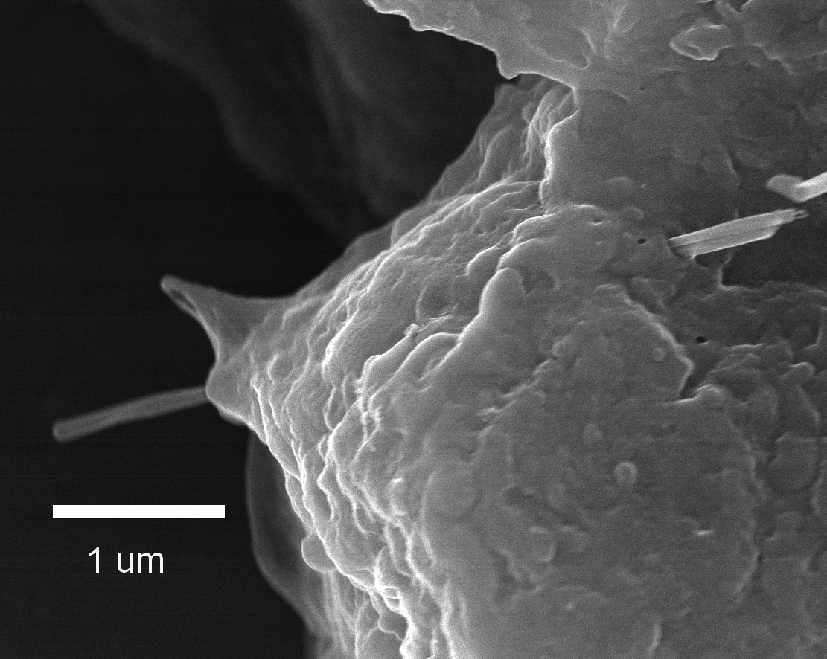
Inhalation Hazards
Certain nanomaterials can
Induce cancers, including mesothelioma
Cause rapid and persistent pulmonary fibrosis
Cause cardiovascular dysfunction
Migrate along the olfactory nerve into the brain
Alveolar Epithelial Penetration by Multi-walled Carbon Nanotube
Courtesy of R. Mercer, NIOSH
Notes:
Trainer Notes:
The growing body of research into the hazards of inhalation exposure of nanomaterials demonstrates the potential for unwanted health outcomes IF there is exposure. Not all types of nanoparticles have demonstrated these hazards and not all the research has been done on commercially relevant forms of the nanoparticles. With those caveats in mind here are some examples of significant findings from the hazard literature.
The image shows a multi-walled carbon nanotube penetrating the alveolar epithelium. This is significant because it suggests that MWNTs that get into the lung have the potential to penetrate the epitehlium and get into the space where mesothelioma originates.
Certain multi-walled carbon nanotubes were able to induce fibrosis and mesothelioma-like symptoms when instilled in rodent lungs. The effect was observed for long, stiff nanotubes (that resemble the shape of the harmful form of asbestos) but not for short, tangled nanotubes. The researchers hypothesized that the mechanism of injury was similar to asbestos because of the fibrous nature of stiff nanotubes.
Single-walled carbon nanotubes and titanium dioxide nanoparticles have been implicated in the formation of arterial plaques
Certain nanoscale metals and metal oxides have been shown to travel along the olfactory nerve and get into the brain.
Sources
Mesothelioma: Nature Nanotechnology 3, 423 - 428 (2008) and The Journal of Toxicological Sciences Vol. 33 (2008) , No. 1 February 105-116
Cardiovascular: Environ Health Perspect 115 (3): 377–382 (2007)
Olfactory: Journal of Nanoscience and Nanotechnology, 9(8): 4996-5007 (August 2009) and Environmental Health Perspectives Volume 114, Number 8, August 2006

Slide 7
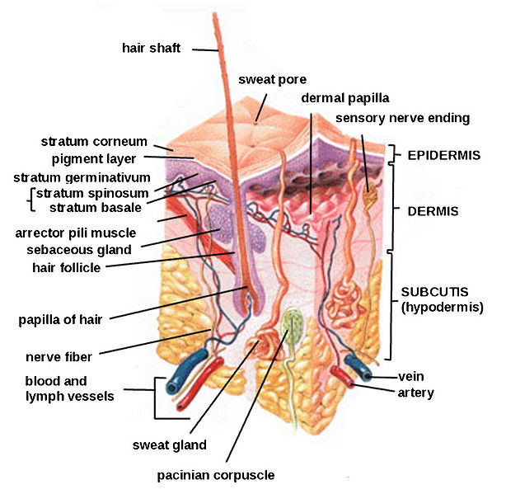
Routes of Exposure: Dermal (Skin)
Available data are limited and often conflict;
Skin cannot be ruled out as a potential route of exposure
Several studies show little to no penetration of nanoscale oxides beyond surface skin layers
Polysaccharide and metal nanoparticles have been shown to penetrate flexed, damaged or diseased skin
Quantum dots were found to penetrate intact pig skin within 8-24 hours at occupationally relevant doses
Notes:
Trainer Notes:
Research on skin as a route of exposure is more limited than that on inhalation. The methods for measuring skin penetration are still evolving and better validation and standardization are needed.
Dozens of papers demonstrate the ability of intact skin to protect against penetration of nanoparticles beyond the surface layers of the skin. This is particularly evident for titanium dioxide and zinc oxide nanoparticles used in topical sunscreens.
Fluorescently tagged polysaccharide (dextran) beads of 500- and 1000-nm diameter were found to penetrate to the dermis when the skin was mechanically flexed. Silver nanoparticles embedded in a wound dressing caused elevated levels of silver to be detected in plasma and urine and graying of the skin (argyria) of a burn patient.
Quantum dots of various sizes, surface coatings and shapes were found to penetrate intact skin to the epidermal and dermal layers within 8 hours. The researchers concluded that the time scale (typical work day) and dosage were relevant for occupational exposures.
Sources
Int Arch Occup Environ Health (2009) 82:1043–1055
IMAGE: http://en.wikipedia.org/wiki/File:HumanSkinDiagram.jpg

Slide 8
Dermal Hazards
Various nanoparticles have been shown to
Inhibit cell proliferation (iron oxide, nanotubes, TiO₂, silver)
Affect cell morphology (silver, nanotubes)
Initiate irritation response (quantum dots, nanotubes)
Damage cell membrane (fullerenes)
Induce DNA damage (cobalt chrome alloy)
Notes:
Trainer Notes:
Dozens of studies have tested toxicity of various nanoparticles to human skin cells in culture. Oxides, metals, quantum dots and carbonaceous nanoparticles have all demonstrated the ability to damage skin cells through a variety of mechanisms, most notably as a result of oxidative stress.
Source
Review of dermal toxicity literature: Int Arch Occup Environ Health (2009) 82:1043–1055

Slide 9

Routes of Exposure: Ingestion
Ingestion is a viable route of exposure;
Ingested nanoparticles can translocate throughout the body
Ingestion may occur after inhalation exposure when mucus is brought up the respiratory tract and swallowed.
Poor work practice can result in hand-to-mouth transfer
Ingested nanoparticles do translocate to other organ systems
  SWCNT delivered into gut for treating Alzheimer’s disease were found in liver, brain and heart
  Ingestion of colloidal silver can result in permanent discoloration of skin, nails and eyes
Notes:
Trainer Notes:
Unintentional ingestion of nanoparticles may result subsequent to inhalation when mucus moves up out of the respiratory tract and is swallowed. (This clearance mechanism is called the mucociliary escalator.)
And, as is the case with other substances in the workplace, poor work practices, such as eating or smoking in the work area, can result in unintentional ingestion.
Occupational exposure via ingestion is perhaps the least well researched of the three pathways discussed in this module. However, the use of nanoparticles as drug delivery agents is a huge area in medical research. Some of these agents are meant to be ingested and then translocate to other areas of the body. This is itself demonstrates that ingested nanoparticles have routes out of the digestive tract and into other bodily systems. For example recently a single-walled carbon nanotube (SWCNT) agent introduced into rodent stomachs through gastrogavage was subsequently found in the liver, heart and brain as well as the lower intestine.
Excess ingestion of “colloidal” silver (much of which contains nanosilver) can result in a permanent discoloration of the skin (argyria) and eyes (argyrosis) from silver depositing into these tissues.
Sources
IMAGE: Microsoft image gallery
SWCNT: Nanomedicine: Nanotechnology, Biology, and Medicine 6 (2010) 427–441
Silver: Journal of Applied Biomedicine 2008, 6(3): 117-129

Slide 10
Ingestion Hazards
Various nanoparticles have been shown to
Slightly damage liver (silver)
Trigger immune response in intestinal dendritic cells (TiO₂ and SiO₂)
Be cytotoxic to human intestinal cells (TiO₂, SiO₂ and ZnO)
Damage DNA of human intestinal cells (ZnO)
Be genotoxic to liver and lungs after oral adminstration (C₆₀ and SWNT)
Notes:
Trainer Notes:
There is limited research about the effects of nanoparticles post-ingestion. However, some studies indicate that certain nanoparticles have the potential to damage intestinal cells and, after translocating out of the gut, induce unwanted health effects in other organs. This research is too preliminary to draw major conclusions and most papers conclude that more research is needed to better understand the effects of ingested nanoparticles.
Sources
Silver liver damage: Particle and Fibre Toxicology, 2010, 7:20 (11 pp)
Intestinal dendritic cells: Nanotoxicology, 2010 Early Online, DOI: 10.3109/17435390.2010.506957
Cytotoxic: Nanotoxicology, 2009 3(4): 355-364
DNA damage: Nanotoxicology, 2009 3(4): 355-364
Genotoxicity: Environ Health Perspect 117(5), 703-708 May 2009

Slide 11
What do we know about Nano-tox?
Much of the early nanoEHS research has focused on simple systems of limited relevance to human health (e.g., cytotoxicity)
Some nanoparticles can translocate throughout the body after exposure via inhalation, contact with skin or ingestion
Some nanoparticles can induce unwanted health effects in animals or cell cultures
It makes sense to control exposure to those nanomaterials for which preliminary hazard data show unwanted health effects or hazards are unknown
Notes:
Trainer Notes:
Go over conclusions and ask for questions

Slide 12
Airborne Exposure:
How much protection do I need?
Many nanoparticles of interest in the center have not been explicitly studied
In some cases, recommended threshold limits for exposure are available in public databases
DOE Protective Action Criteria:
NIOSH Permissible Exposure Limits (PEL):
http://www.atlintl.com/doe/teels/teel.html
(database for 60-minute exposure levels)
https://www.osha.gov/dsg/annotated-pels/
Different tables for short-term acute exposure, chronic exposure as part of an 8-hour day, etc. These will differ by orders of magnitude, so make sure you know what you’re looking at.
Notes:
For people working in the center, the biggest hazard is likely to be from airbone exposure. To really evaluate the potential risk, we need to know whatconcentrations are likely and what we know about toxicity thresholds. Before doing that, let me remind everyone that many of the nanoparticles of interested to the center have not been extensively studied for their toxicity. As we move from simple materials like TiO2 and gold to more complex materials, there’s greater uncertainty in what we know. This is not that much different from chemical safety, in that in many cases when you get an MSDS safety sheet there’s not much information there. So, we need to use intelligent estimates.
For metallic mateirals, threshold limits have been determined by DOE and/or NIOSH (National Institute for Occupational Safety and Health). NIOSH tends to focus on exposures relevant to people working with materials on an 8-hour-per-day basis. Here are links to two of these. The recommended limits depend on the length of exposure and these will differ by orders of magnitude, so it’s important to know what yhou’re looking at.

Slide 13
Example materials within the CSN:
LiNiMnCoO₂ (“NMC”) (Ni, Co, Mn?, Li)
LiCoO₂ “LCO” (Co)
CdSe quantum dots (Cd, Se)
Notes:
I’m going to very briefly walk through a couple examples, using materials relevant to the CSN. All of these mateirals contain metals that have some known toxicity for inhalation, such as Ni and Co.

Slide 14
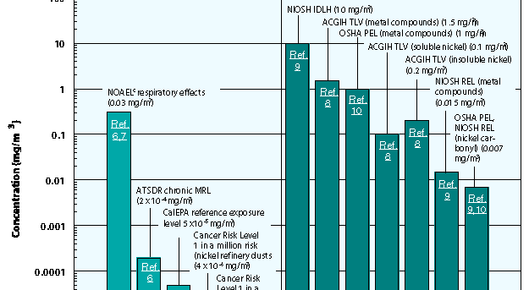
Example 1: Nickel
Immediate Danger
To Life and Health
(IDLH)
Threshold Limit Values (TLV)
Permissible
Exposure
Limits (PEL,REL)
http://www3.epa.gov/airtoxics/hlthef/nickel.html
Recommended exposure limit
0.015 mg/m³ (averaged over 8 hour day)
1 mg/m³ (short-term)
Notes:
Here’s an example for nickel, from the EPA. I’ve divided it into three ranges, corresponding to “immediate danger to life and health”, “Threshold limit values” (that is, the ranges where some physiological effects are observed), and the permissible exposure limits, where little or no effects are observed. Again, the NIOSH values are typically based on 8-hour-per-day exposure, 40 hours/week. Base don that, we can see that a reasonable permissible exposure would be on the order of .02 milligrams/m3.

Slide 15
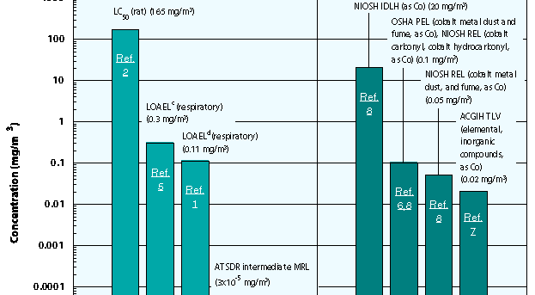
Example 2: Cobalt
http://www3.epa.gov/airtoxics/hlthef/cobalt.html
Recommended 8-hour daily limit, 0.02-0.05 mg/m³
Notes:
Here’s another example, for cobalt. Again, a reasonable limit would be about 0.02 mg/m3.

Slide 16
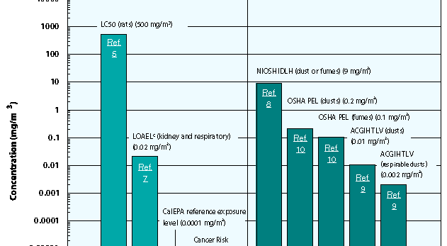
Example 3: Cadmium (e.g., CdSe QD’s)
30 min
8-hr day
Recommended 8-hour daily limit, 0.002 mg/m³ airborne dust
30-minute limit: 9 mg/m³
http://www3.epa.gov/airtoxics/hlthef/cadmium.html
Notes:
Here’s cadmium. Cd has toxicity about an order of magnitude higher, so a recommended exposure limit of about 2 micrograms/m3.

Slide 17
Some CSN-relevant exposure limits:
(8-hour day)
Li: 4 mg/m³
Ni: 0.015 mg/m³
Co: 0.02 – 0.05 mg/m³
Cd: 0.002 mg/m³
Now we have some knowledge of how much is “safe”.
Next Questions:
How much is a typical batch of nanoparticles?
How much is likely to get dispersed into the air?
How effective must our respiratory protection be?
http://www3.epa.gov/airtoxics/hlthef/
*Sittig's Handbook of Toxic and Hazardous Chemicals and Carcinogens
Notes:
So, some of the limits relevant to CSN mateirals are in the range shown here. The next questions we
need to ask is, how much is likely to be in the air?

Slide 18
Consider an example:
Typical lab: 20 ft x 30 ft x 10 ft = 6000 ft³= 170 m³
Assume 10 mg dispersed into 170 m³ → 0.06 mg/m³ (assuming no air exchanges, stagnant air)
In reality, air changes 4-12 times per hour in typical laboratory room. Assume 4 times/hr, 8 hrs = 32 exchanges
8-hour time-averaged concentration=.06/32 mg/m³ = 0.002 mg/m³
This value is comparable to the recommended exposure limit for Cd (assuming 8 hours/day exposure on a continuous basis)
In most cases, the amounts of materials behind handled within the CSN are small enough that it is unlikely to exceed OSHA standards.
Those making materials will always have some additional risk of exposure.
Plan for the worst and build in extra protection.
Notes:
Here’s a very crude estimate. Assuming a typical lab room, if we had 10 milligrams dispersed, we’d be at .05 mg/m3 if the air was stagnant. But in reality the lab air is exchanged, typically 4-12 times per hour. So, if we do some math, we’d estimate that we’d be around 2 micrograms/m3 averaged over an 8-hour day.
In general, the amount sof mateirals being handled within the CSN are small enough that it’s unlike to exceed OSHA standards. However, those who are making the materials, especially if in dry form, need to be cognizant of the potential hazards. So, we plan for the worst and build in extra protection.

Slide 19
Hierarchy of protection
Elimination
Substitution
Modification
Containment
Ventilation
Work Practices
Personal Protection
Global protection
Policy & Regulatory
controls
CSN
Engineering controls
Lab-scale protection
Individual
controls
Individual protection
Adapted from http://www.cdc.gov/niosh/topics/ctrlbanding/images/hierarchy_of_controls.jpg
Notes:
Trainer Notes:
Adapted from http://www.cdc.gov/niosh/topics/ctrlbanding/images/hierarchy_of_controls.jpg
This graphics shows the industrial hygiene hierarchy of controls. Controls are listed in decreasing order of preference. Modification, containment and ventilation are considered engineering controls and will be discussed in this presentation. Elimination and substitution were previously discussed and are preferred over engineering controls. Work practices, or administrative controls, and personal protective equipment are less desirable controls than engineering controls and will be discussed in the near future.

Slide 20
We need to consider these factors
mild / reversible
Occupational Health Hazard
severe / irreversible
kilograms
8 hours
Engineered Local Exhaust Ventilation
Exposure Risk
Quantity
Task Duration
Closed Systems
milligrams
15 minutes
slurry/suspension
agglomerated
highly dispersed
Physical Form
Courtesy NIOSH
4-20
Notes:
Trainer Notes:
We need to consider these factors.
[Work through each element and describe why the exposure risk would increase. As that risk increases, the controls go from ventilation to a closed system. You should point out that these parameters will be seen later when we review control banding.]

Slide 21
Engineering Controls: Containment
Elimination
Substitution
Modification
Containment
Ventilation
Work Practices
Personal Protection
What are some examples of containment for nanoparticles?
4-21
Notes:
Trainer Notes:
The first thing we want to do is focus on containment. How can we control where the nanoparticles, by confining them somehow.

Slide 22
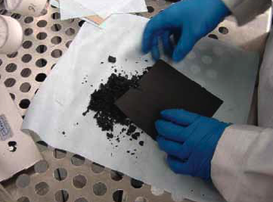
Nanoparticles are often provided and worked in a wet state to reduce the risks of airborne exposure
Photo courtesy Mark Methner, NIOSH
Notes:
Trainer Notes:
One way of temporily confining the NPS is to keep them wet.
Of all the the things you can do to reduce exposure, this is the one that is easiest and has the biggest impact. Of course, you also need to remember that wet nanoparticles might also be reacting (NMC, for example) and will not necessarily stay wet, which becomes important once you’re done with your experiments, in how you dispose of them.

Slide 23
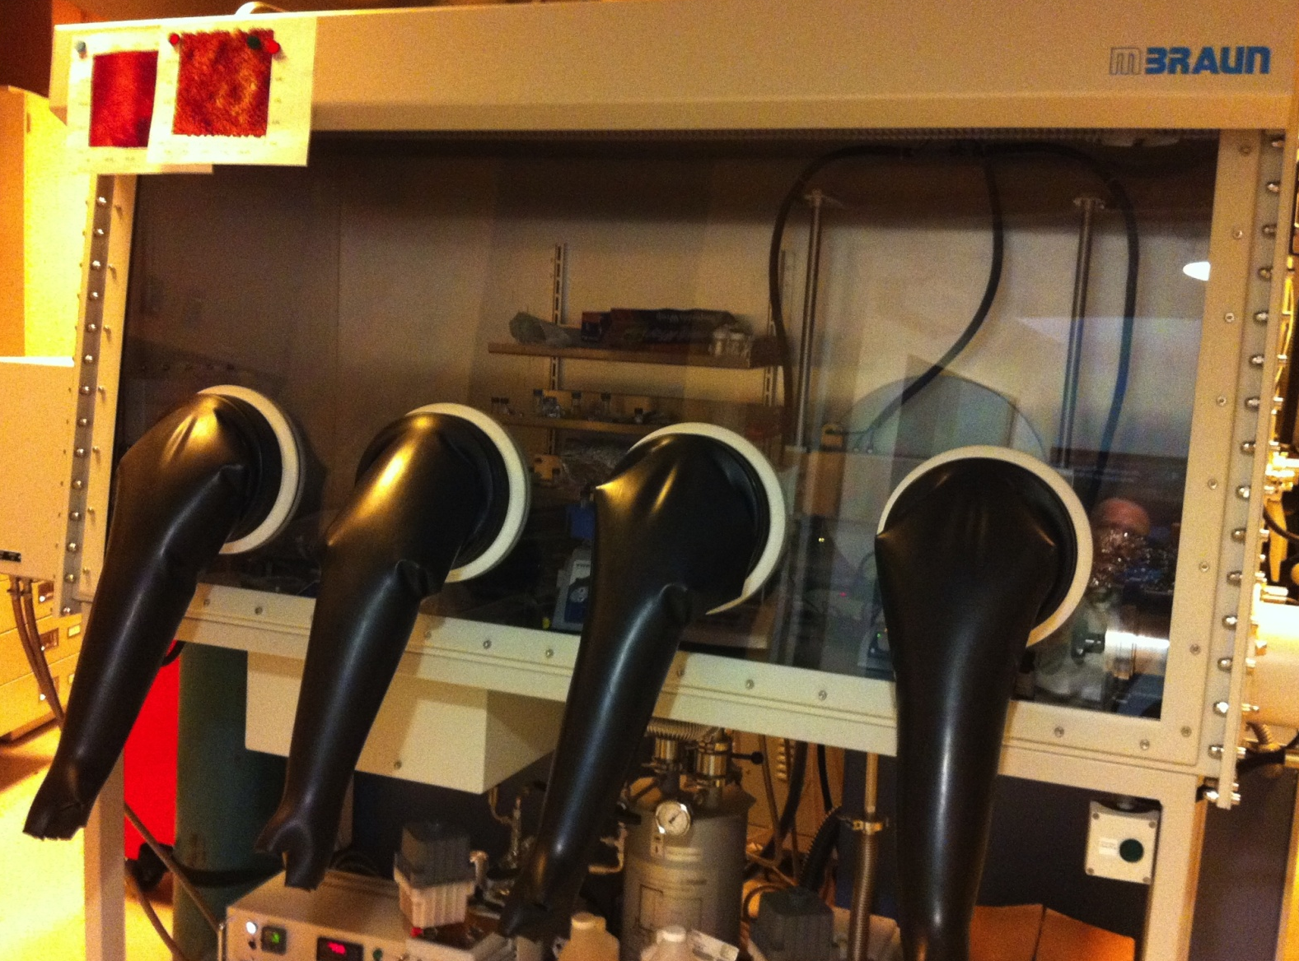
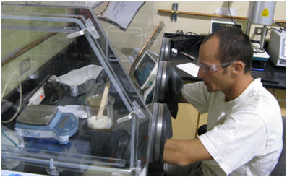
Glove boxes
Glove boxes of this type are often positive internal pressure, such that a pinhole in a glove will push the internal contaminants toward you (not good)
Low air current facilitates weighing operations compared with regular fume hood
Notes:
Trainer Notes:
One way of protecting yourself is using a conventional glove box. Most glove boxes are designed to have positive pressure because they’re designed to keep air out…. But a pinhole in a glove will then push air out at you.

Slide 24
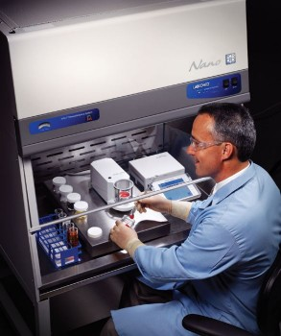
Ventilated Workflow
At PNNL:
All dry nano work must be performed in special
Nano hood
Air flow pulled into box, with “ULPA” 99.999% efficient on 120 nm particles (Labconco “Xpert Nano”)
Cost ~ $6k
Notes:
Trainer Notes:
Another really good option is to use a ventilated workstation. Some manufacturers are now making these with built-in filters
that will filter out nanoparticles. One example is this one from Labconco and the “Xpert Nano”. It costs about 6k. At PNNL, all work with dry nanoparticles must be performed in this special “nano hood”. Others making NPS might want to consider getting one of these, if they’re reasonably able to do their NP work in one small space.

Slide 25
Engineering Controls:
Ventilation
Elimination
Substitution
Modification
Containment
Ventilation
Work Practices
Personal Protection
What are the two main divisions?
1) dilution ventilation
2) local exhaust ventilation
4-25
Notes:
Trainer Notes:

Slide 26
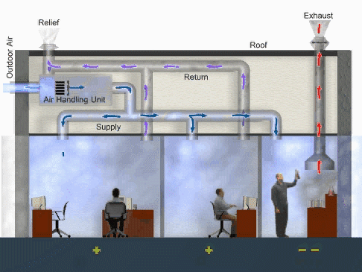
Dilution ventilation (typical laboratory and office air supply) supplies some outdoor air, but mostly recycles room air.
Graphic courtesy EPA
4-26
Notes:
Trainer Notes:
In a regular office environment air get recycled to reduce energy usage. Lab areas are designed to have greater air turnover, and chemsitry-type lab hoods take air directly out of the building, without recycling. This graphic shows a functioning dilution ventilation system with local exhaust ventilation in the right most room. The air handling unit mixes outdoor air with return air and conditions it before it is supplied to each of the rooms. Conditioning may included heating, cooling or adjusting the humidity of the air. Notice that the air enters each room on one side and leave the other side to ensure good mixing. The plus signs below the left two rooms indicate the pressure in the these rooms is greater than the right most room which has negative signs below it. Higher pressure in the offices ensures that if there are leaks between them and the laboratory that air will flow into the lab and minimize the number exposed.
http://www.epa.gov/iaq/largebldgs/i-beam/visual_reference/series_1/index.html

Slide 27
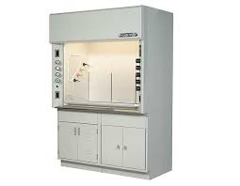
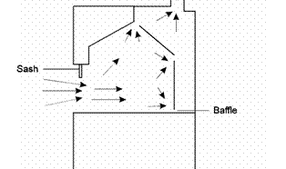
Chemical Safety hoods
Air is sucked into the hood and out through exhaust (to roof of building)
Most common protection in chemistry laboratories
Presumably NPs aggregate during the process.

Slide 28
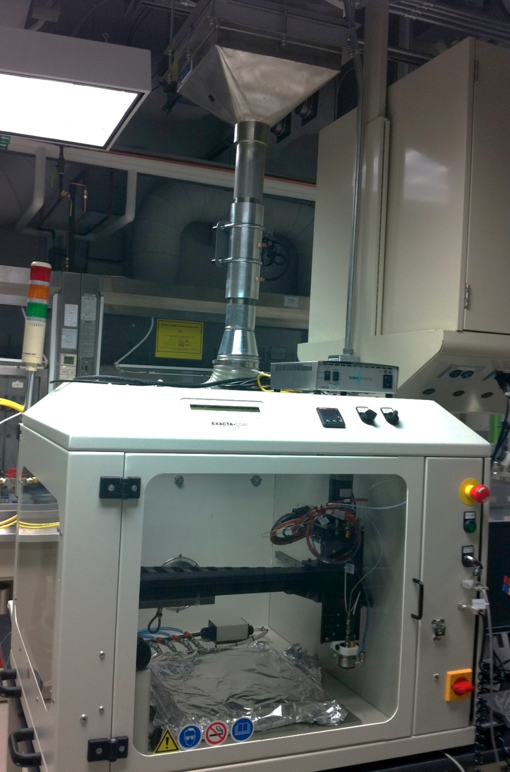
Industrial nano reactor This unit has HEPA filters on the exhaust system to capture NPs.
(HEPA= “High Efficiency Particular Air”. more on HEPA filters later..)
Nanoparticle Filtering systems
Courtesy Oak Ridge’s Nanophase Materials Research facility
Notes:
Trainer Notes:
Nanoparticle enclosures and gloveboxes often have HEPA filters on their exhaust systems.

Slide 29
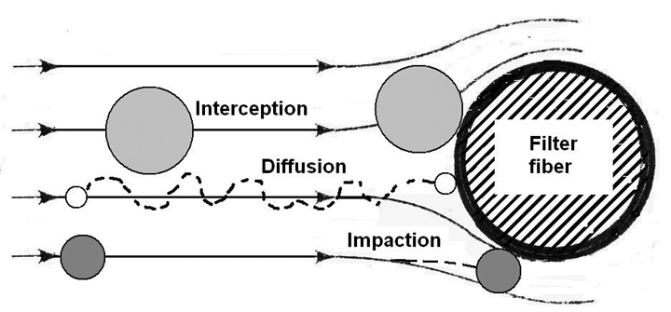
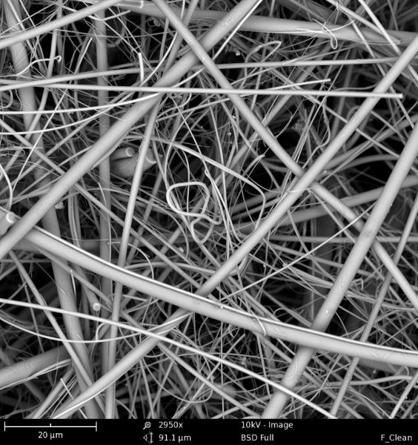
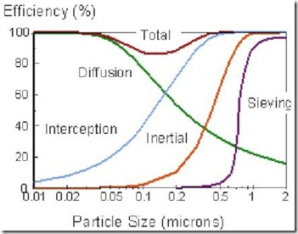
Airborne NP removal by HEPA filtration
HEPA= High Efficiency Particle Air
HEPA filtration media
www.asbestosguru-oberta.com
http://www.nanoscience.com/applications/fibers/image-gallery/
Notes:
A HEPA filter is just a highly porous membrane. HEPA filters are able to capture nanoparticles by several different mechanisms, that have differenet efficiencies as a function of nanoparticle size. The important thing here is that the efficiency of filtration systems has a minimum that occurs for particle diameters in the 100-500 nm range, depending on the filter.

Slide 30
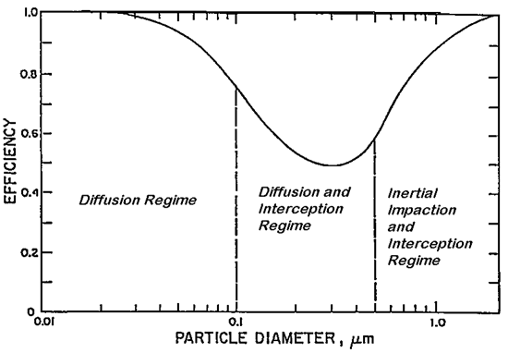
HEPA filters work for NPs too !
HEPA filter must be >99.97% effective at removing 300 nm diameter nanoparticles. This is the most difficult size to trap, so HEPA filters are even more effective at removing smaller NPs.
Used HEPA filters must be handled carefully.
http://blogs.cdc.gov/niosh-science-blog/2009/10/14/n95/
4-30
Notes:
Trainer Notes:
IN order to be called “HEPA”, a filter must be >99.97% efficienct for capturing nanoparticles with a diameter of 300 nm. The minimum in efficiency depends on the construction of the filter.
This is a concept that many people don’t un
derstand because it isn’t intuitive. Most people when they think of filters, think of screens and assume that particles below a certain size naturally get through. This graph points out that the reason HEPA is defined as a filter that is 99.97 percent efficient at a 0.3 micrometer Median Mass Aerodynamic Diameter. That is the toughest particle size to capture because it is too small to catch with impaction, but too large to operate by diffusion. It operates under Brownian Motion. Consequently, if you can capture particles of 0.3 micrometer dimension at 99.97% efficiency, you do better with larger particles and with smaller partlcles, as this graph indicates.

Slide 31
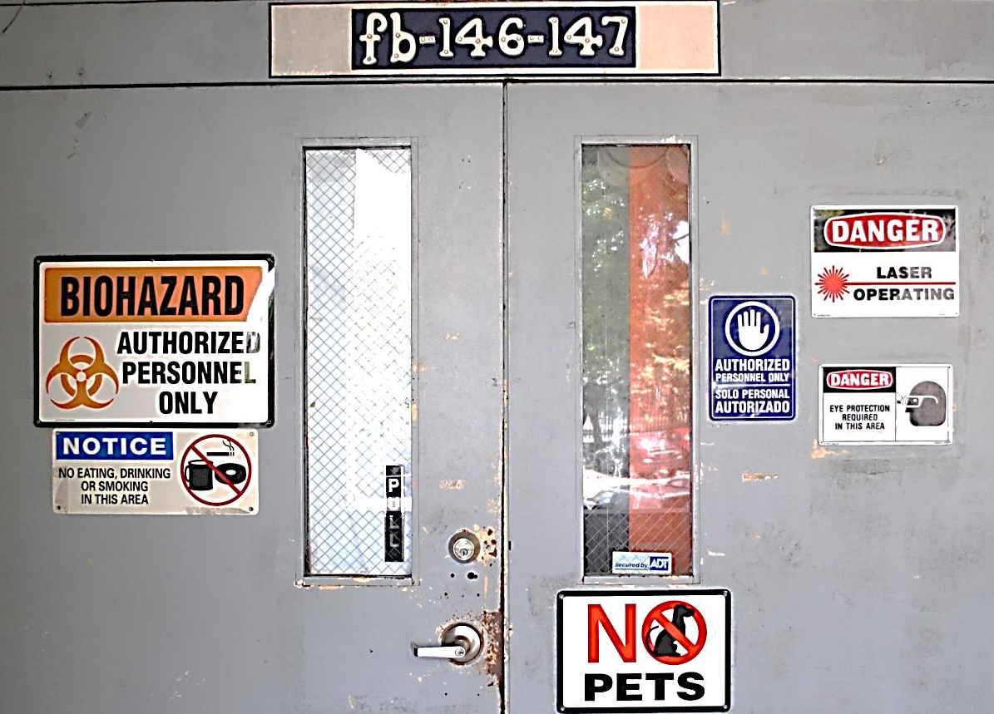
Administrative Controls:
Work Practices
Elimination
Substitution
Modification
Containment
Ventilation
Work Practices
Personal Protection
What practices could make a difference?
Notes:
Trainer Notes:
[Point out to the class that we are near the bottom of the hierarchy. Ask what work practices could make a difference.]

Slide 32
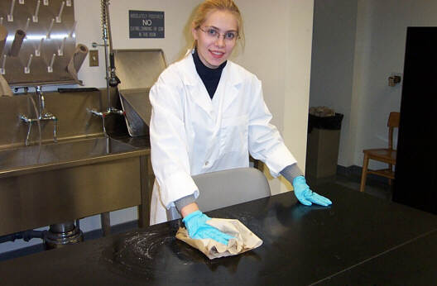
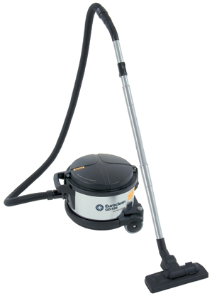

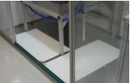
Work Practices: Keeping NPs away!
Lab benches:
Wet-wiping counters
(bag used wipes before disposal!)
HEPA-vacuum lab benches
Floors:
HEPA vacuum
Web-mopping
Sticky mats
Source: NIOSH and Oak Ridge National Laboratory
4-32
Notes:
Trainer Notes:
Your own work practices can have a big effect on NP exposure for you and for other people. Some of the easy things to do are to wet-wipe conters, use a HEPA vacuum on lab benches and floors, wet-mop floors, and use stick mats like these shown here.
[Review these commonsense work practices that came from NIOSH and Oak Ridge National Laboratory.]
Work practices for cleanup at end of the shift:
Clean work areas using either a HEPA-filtered vacuum or wet wiping
Cleanup in a manner that prevents contact with wastes
Comply with all federal, state and local regulations when disposing wastes
Wash hands frequently, particular before eating or leaving the worksite
Wear assigned PPE and keep it maintained properly
Use sticky mats and gowning procedures

Slide 33
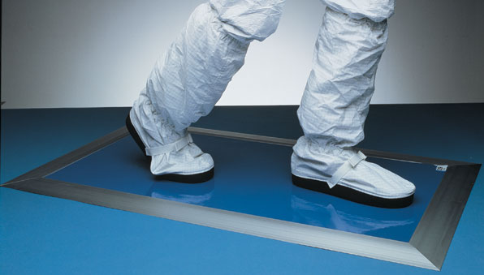
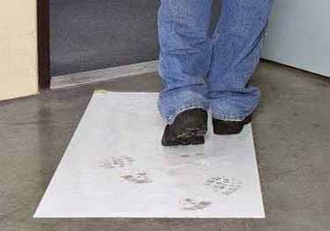
Sticky mats
Sticky mats come in packages of ~ 30 mats/pad, usually sold a a set of 4 pads
Large (3’ x 5’) mats cost: ~$1 per mat
1-year cost with daily replacement about $350
Notes:
Trainer Notes:
[This is inside the Nanoparticle Containment Room and shows a green floor that is a permanent, washable, tack-regenerating mat designed specifically for the removal of footborne and wheelborne contamination. It covers the cracks and depressions in normal concrete flooring that hold contamination. In addition, there is a Sticky Mat is a stack of sheets of polyethylene film, with a specially treated pressure sensitive adhesive on one side, upon which persons entering a cleanroom or clean zone walk (and vehicles are rolled) to remove the last trace of contamination on shoe heels and soles, and on wheels. When a sheet becomes loaded with contamination, it is peeled off, exposing a new clean sheet for use, thus eliminating messy and time-consuming cleaning and washing.
This is in the section on work practices because proper replacement of sticky mats is critical and constitutes a good work practice. It is part of the broader work practices of decontamination.]

Slide 34
Personal Protective Equipment
Elimination
Substitution
Modification
Containment
Ventilation
Work Practices
Personal Protection
Why is PPE at the bottom?
4-34
Notes:
Trainer Notes:
Why is Personal Protection at the bottom ?
Ask the question: Why is PPE at the bottom? You should get responses that note that this relies on workers each time to get the fit right and it doesn’t remove the contaminant or lessen its concentration.

Slide 35

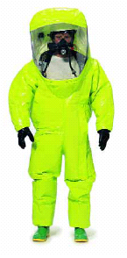
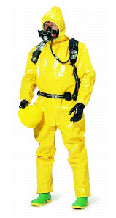
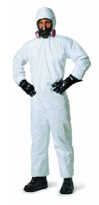


Personal Protective Equipment Overview
Which level do you think we may need for handling nanoparticles?

Slide 36
Appropriate Protection
Body
Hands
Eyes
Foot
Respiratory

Slide 37
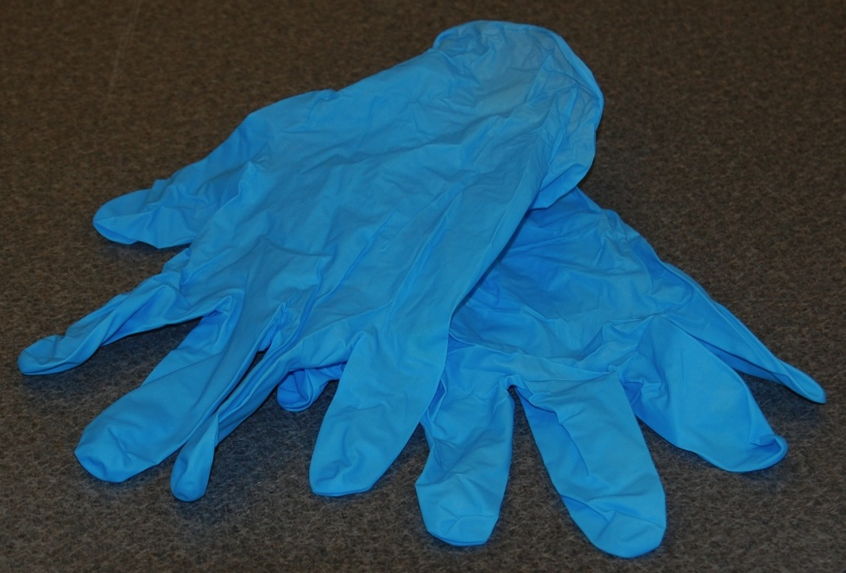
Hand protection
Small nanoparticles may enter the body through the skin
NIOSH recommends wearing
gloves whenever handling nanopartilces
Nitrile (most generally used)
Neoprene
Polyvinyl chloride (PVC)
Latex
Nitrile gloves
4-37
Notes:
Trainer Notes:
NIOSH recommends wearing hand protection when working with nanoparticles. There is limited data indicating penetration of the skin by nanoparticles, but cuts in the skin may offer an easier path. Point out that disposable nitrile gloves are the most widely used because they provide protection against a wide range of chemicals, but it is important to check what glove is recommended for specific chemicals. This information can be found at most glove manufacturers’ websites.

Slide 38
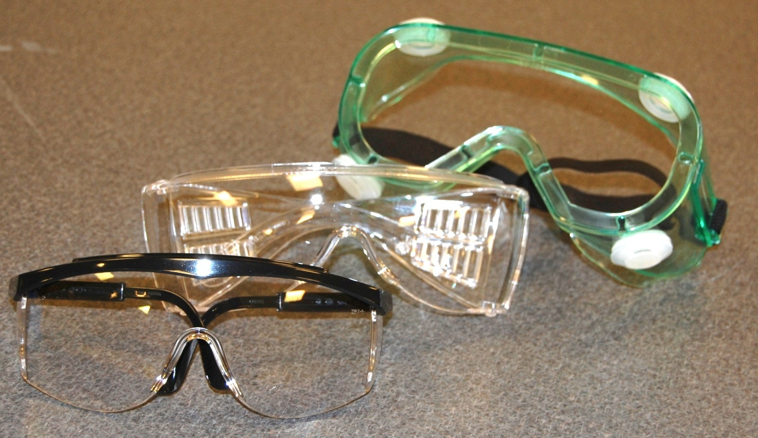
Eye Protection
Eye protection with splash shields is standard practice in any laboratory and should always be used.
Goggles are even better.
Sometimes eye protection is combined with respiratory protection
Must meet ANSI Z-87.1
4-38
Notes:
Trainer Notes:
Eye protection may also be necessary. Ask when goggles would be preferred over safety glasses. You should get the answer that goggles prevent splashes from getting in the eyes much better than safety glasses. All must meet a specific standard from the American National Standards Institute called ANSI Z-87.1

Slide 39


Body protection: Lab Coats
Disposable Tyvek lab coats
~$5.-10 each
Re-usable (washable) labcoats
Tyvek labcoats provide much better protection against nanoparticles but can melt upon exposure to flame
http://www.safetysupplyamerica.com/p-2989-tyvek-lab-coat-snap-front-collar-no-pocket-30case.aspx
https://depts.washington.edu/chem/courses/images/coat.jpg

Slide 40
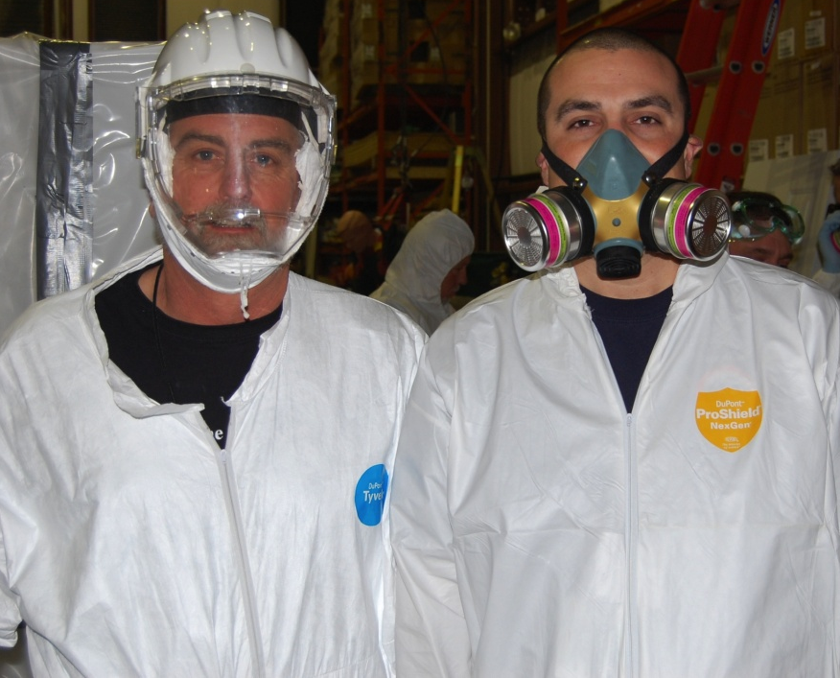
Respirators may be required or recommended for some nano operations when engineering controls cannot reduce NP exposure to an acceptable level.
Respiratory protection
In a commercial setting, OSHA’s standard (1910.134) would apply, requiring:
Written program
Training
Medical evaluation
Fit testing
Respirator maintenance program
Notes:
Trainer Notes:
Respirators may be required for some nano operations. If so, OSHA’s standard (1910.134) would apply. It would mandate the company having:
Written program
Training
Medical evaluation
Fit testing
Respirator maintenance program

Slide 41
Respirators are classified by 2 parameters
Oil Resistance
Effectiveness
N
Not resistant
R
Resistant
P
Oil Proof
95%
99%
100% (>99.97%)
= “HEPA”
x
Oil resistance rating is important in many manufacturing settings, but unlikely to be important in CSN lab environments.
N and P are both commonly found
Tested with 300 nm NaCl (N) and/or dioctylphthalate aerosol (R,P)
Notes:
Trainer Notes:
NIOSH researchers noted that oil, like that found in the oil mists of factories where metal working equipment is constantly lubricated, was significantly damaging the filtration medium for particulate respirators. Consequently, they established a new classification system under 42 CFR 84 that set up 3 classifications for particulate respirators:
N = Not resistant to oil
R = Resistant to oil, which generally means good for one shift in oil mist
P = Oil Proof, which is good for prolonged use in oil mist

Slide 42
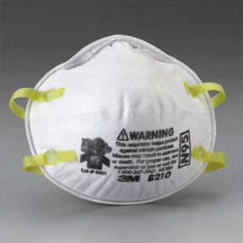
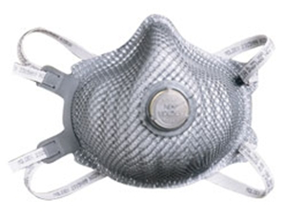
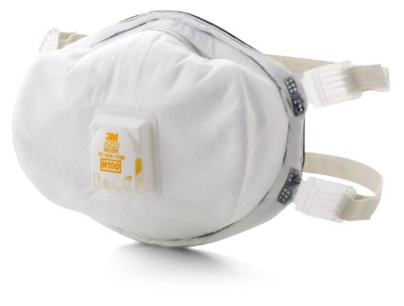
Example disposable particle respirators
N95
N99
N100
Moldex 2310
3M 8233
99.97% capture
3M 8511
$2.50 each
$5.00 each
$10.00 each
Examples taken from web site of Cooper Safety
http://www.coopersafety.com/

Slide 43
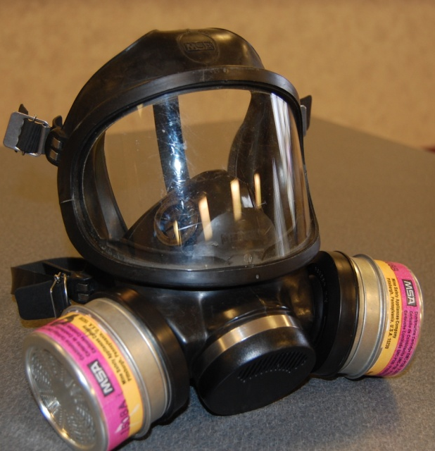
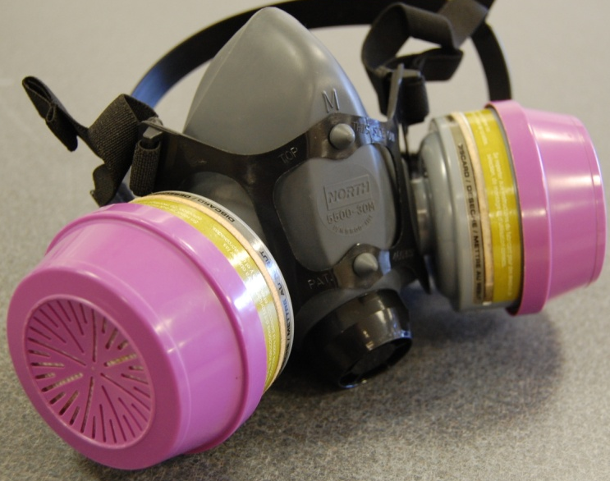
Cartridge-style respirators:
Full-face
Half-face
3M P7500 respirator
($35.00, +$10 for replaceable cartridges)
Cartridge-style filters are more effective than disposable “dust-mask” style filters due to improved fit around bridge of nose.
OSHA considers full-face respirators to be 5x more effective than half-face respirators because of the improved fit around forehead instead of bridge of nose
EPA requires full-face N-100 cartridge respirators for CNT manufacturers unless they prove no exposure
https://multimedia.3m.com/mws/media/565214O/3m-cartridge-filter-guide-and-brochure.pdf
Notes:
Trainer Notes:
Respirators can be further divided based on facial coverage. They are either full-face or half-face. Which offers more protection? The important point to make here is that a full-face isn’t given additional points for eye protection (as many workers think). Full-face respirators have a major design advantage: they go across the forehead. Building a respirator that goes across the forehead is much less problematic than trying to cover the bridge of the nose where there is much greater human variation. Not surprisingly, the greatest leakage occurs at the bridge of the nose. Consequently, OSHA gives half-face respirators an applied protection factor of 10 while full-face are given 50.

Slide 44
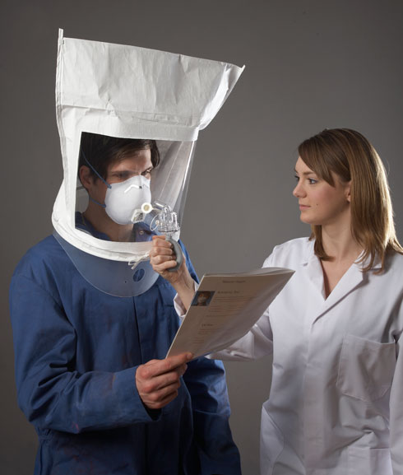
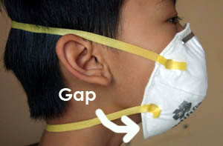
Proper fitting to OSHA standards is a complicated process that includes reading about pots of gold at the end of the rainbow (really!) *
If you do not properly fit the mask to your face you will not get the expected protection.
Common disposable N95 filters are difficult to fit properly around the nose and chin.
*https://www.osha.gov/pls/oshaweb/owadisp.show_document p_table=STANDARDS&p_id=9780
A simpler but less rigorous test: https://www.youtube.com/watch?v=eVgXTXKc5A8

Slide 45
Effective use of respirators
Effectiveness of respirators hinges on having a good fit to the face. There are ways of testing this.
OSHA does not allow use of repirators with beards. All respirator users must be clean-shaven
Filters need to be replaced at an appropriate interval
(when difficult to breathe, or on regular basis of ~30 days)
https://multimedia.3m.com/mws/media/565214O/3m-cartridge-filter-guide-and-brochure.pdf

Slide 46
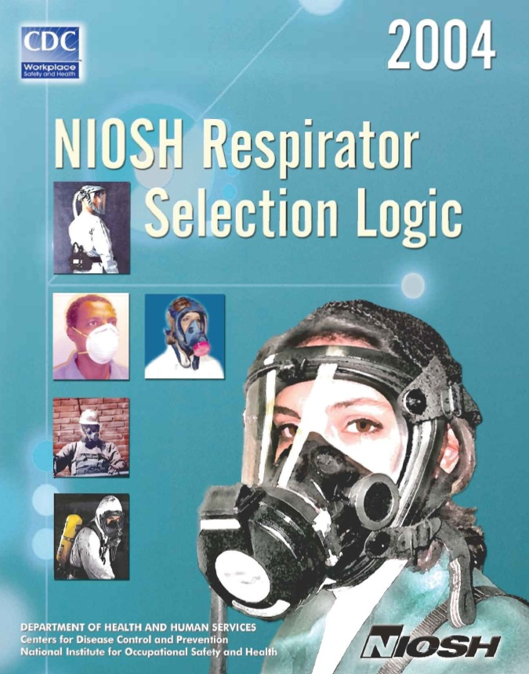
NIOSH has developed a selection logic that can be applied to nanoparticles
http://www.cdc.gov/niosh/docs/2005-100
Notes:
Trainer Notes:
NIOSH has developed a selection logic that can be applied to nanoparticles

Slide 47
Prudent Practices: Safety is Everyone’s Responsibility
Safety is everyone’s responsibility
Failure to maintain good safety procedures could endanger your lab-mates as well as yourself
Proper safety procedures will vary with local lab environments and available engineering protections (hoods, etc.)
Nobody can keep you safe but yourself!

Slide 48
Prudent Practices: Know your materials!
Know what you have
If available, read MSDS and be familiar with chemical properties
Recognize that we may be working with materials with unknown or poorly documented chemical toxicity and reactivity.

Slide 49

Prudent Practices: Minimize airborne exposure
Clean up nanoparticle work areas frequently using wet wipes
Clean up any solid spills immediately using wet wipes
Wet-mop lab floors or use sticky-mats
Dispose of NP-contaminated waste safely as per local rules/regulations

Slide 50
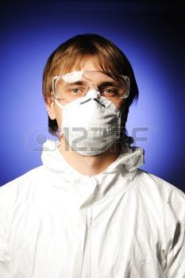
Prudent Practices: Wear proper lab attire
Closed-toed shoes
Long pants
(Tyvek?) Lab coat
Goggles
Gloves
Possibly work with respirator if working with dry nanoparticles in large quantities.

Slide 51
Prudent Practices: NP disposal
Wet wipes or other “wet” NP waste should be bagged in plastic zip-lock bags while still wet (before disposal) to reduce airborne exposure to custodians or other personnel.
Never put NPs into the trash without proper containment
Dispose of all NPs and NP-contaminated waste in accordance with your local chemical hygiene office.

Slide 52
Be Safe !!

Slide 53
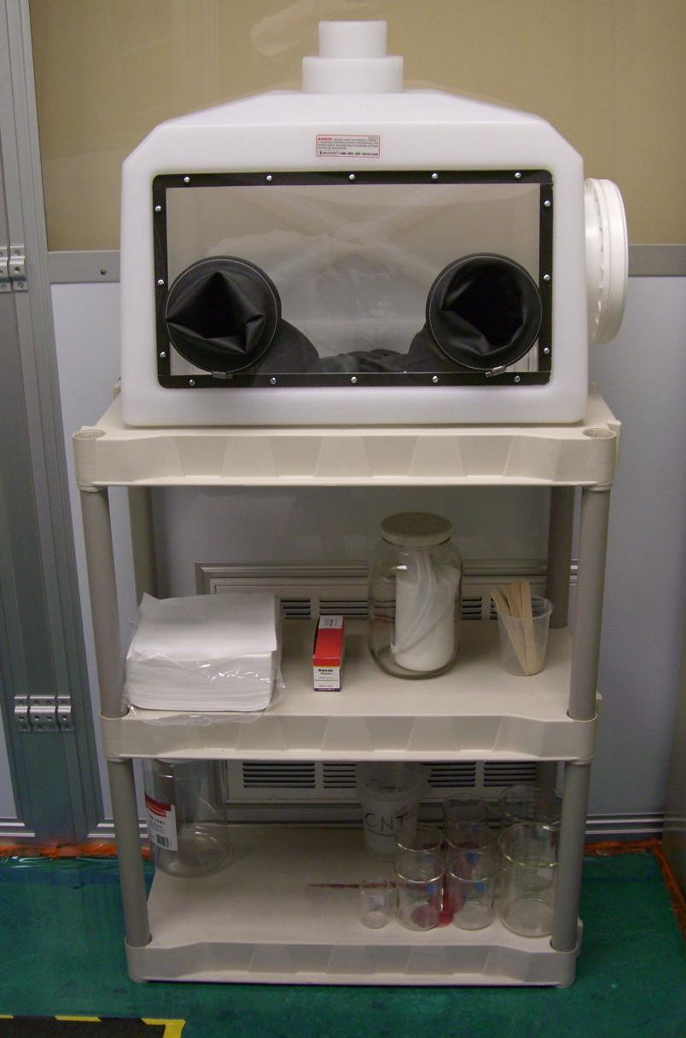
Gloveboxes inside a “Nanoparticle Containment Room”
Photos courtesy Jitendra S. Tate, Ph.D., Professor, Texas State University-San Marcos
4-53
Notes:
Trainer Notes:
Nanoparticle Containment Room.
Specialized Nanoparticle Containment Room for Carbon Nanotubes and Related materials
Texas State University does not allow the use of carbon nanotubes in glove boxes with other materials, but instead isolate the operation in a portable clean room referred to as the ‘Nanoparticle Containment Room’. This room is designed and manufactured (as per our requirements) by Liberty Industries, Inc. Berlin, CT 06023. This room has been installed in one small room within the lab. Please, refer Figure 2.
The Ingram School of Engineering has spent about $6000 on the glove box and $15,000 on the ‘Nanoparticle Containment Room’. The following are the highlights of this nanoparticle containment room.
This is 8’ x 10’ hard-wall ready-made clean room
This room maintains negative pressure and there is dedicated exhaust to this room (with blower on the roof).
The filters used are ULPA (Ultra-Low Penetration Air) Filters rated 99.999% efficient with particles 0.12 microns (120 nm) in diameter. Traditional HEPA filters are good up to 0.3 microns (300 nm) with rated efficiency of 99.98%.
Researchers who would like to use this room have to wear half-mask respirator, lab suit, and other personal protected equipment (PPE).
All these people will have to pass ‘Pulmonary Function Test’ and undergo ‘Respirator Training.’
PI, 3 technicians, and 3 students have undergone this training in summer 08.

Slide 54
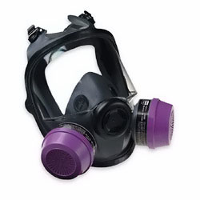
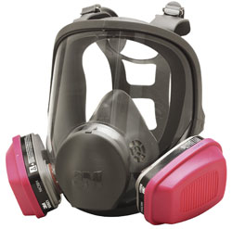
EPA requires full-face N-100 cartridge respirators for CNT manufacturers under consent order, unless they prove no exposure
MSA Full-face Respirator
Courtesy MSA
North Full-face Respirator
Courtesy North Corporation
Notes:
Trainer Notes:
EPA requires full-face N-100 cartridge respirators for CNT manufacturers under consent order, unless they prove no exposure

Slide 55
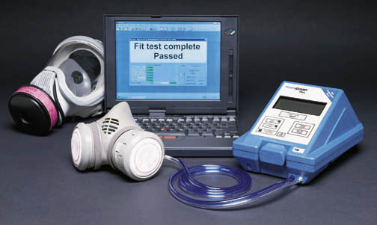
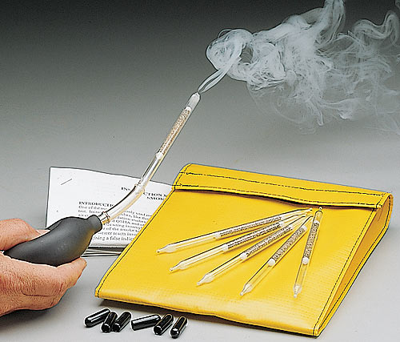
OSHA requires that workers pass a fit test before wearing a respirator
Quantitative
Qualitative
Both are acceptable. Which is better?
PortaCount Quantitative Fit Testing System
Courtesy TSI, Inc.
Allegro Complete Smoke Fit Test Kit Photo Courtesy Gempler’s
4-55
Notes:
Trainer notes:
OSHA requires that workers pass a fit test before wearing a respirator. This is critical. A worker has no idea if a respirator fits unless it is tested. OSHA accepts either quantitative or qualitative. The picture shows a blue Portacount unit that measures the number of particles outside the respirator and then inside the respirator and provides a protection factor by dividing the outside number by the inside number. Qualitative uses approved test agents like irritant smoke, saccharine or isoamyl acetate to challenge the fit to see if the wearer can detect the agent.
Click the advance and then ask which is better? There is no right answer, but most practitioners prefer to test with a quantitative unit because you can see the different fits that are afforded with various manufacturers. Medium size half-face respirators can provide dramatically different fits on an individual. You can’t determine this with qualitative testing. It is either yes or no.

Slide 56
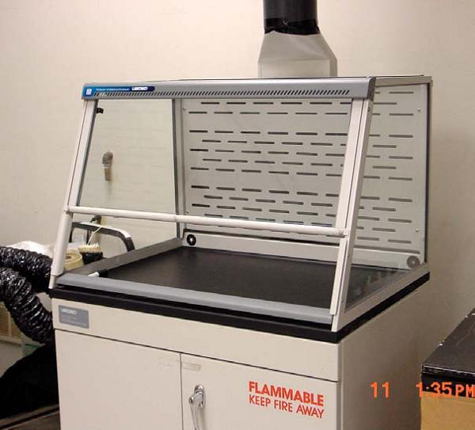
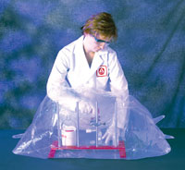
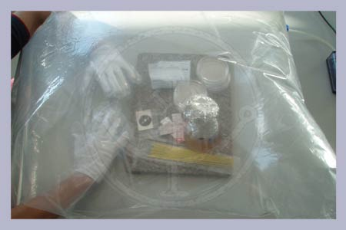
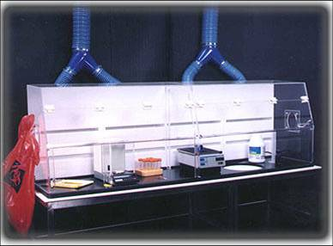
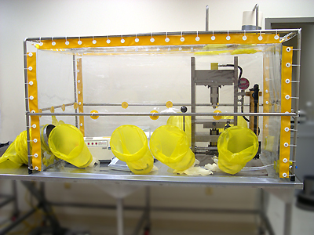
Effective controls for lab-scale work are available including low-flow lab hoods
4-56
Notes:
Trainer Notes:
[Point out that two of these units are disposable and cheap. Not all ventilation units have to be expensive and permanent.]
Effective controls for lab-scale work are available, including low-flow lab hoods.

Slide 57
NIOSH found no evidence of nanoparticles passing through respirator filters at a higher rate (2-07)
U. of MN tested respirator filter media to 3 nm
Flat plate tester
NIOSH found no evidence of that NPs with diameter<20 nm pass through filters at higher rate than >20 nm particles. (done with Ag NPs)
University of Minnesota’s Center for Filtration Research
4-57
Notes:
Trainer Notes:
FROM the NIOSH 2-07 report, “Progress Toward Safe Nanotechnology in the Workplace”: This device is a flat plate test system for measuring respirator filter penetration of 3 to 20 nm silver particles. Scientific information is available to characterize the efficiency of respirator filtration for particles larger than 20 nm in diameter. However, less is known about smaller particles. To increase knowledge and understanding of these smaller particles, NIOSH funded a study in 2005 at the University of Minnesota’s Center for Filtration Research. The purpose of this study was to measure the penetration of nanoparticles between 3nm and 20nm in size through various filter media, including glass fiber, electret, and nanofiber. The respirator filter media tested in this study effectively collected nanoparticles down to 3nm in size. There was no evidence that particles in this size range pass through filter media at a higher rate than the larger particles. The NTRC is planning studies to validate these findings using NIOSH-approved respirators,and to evaluate the likelihood of worker exposure to nanoparticles when his/her respirator does not fit correctly.

